Slide 1
Find the method to predict the future hydropower generation
10/31

Slide 2
Literature Review
Alejandra (Former research intern)
Applying a Correlation Analysis Method to Long-Term Forecasting of Power Production at Small Hydropower Plants
Projecting changes in annual hydropower generation using regional runoff data
The Role of Rainfall Variability in Reservoir Storage Management at Hydropower Dam

Slide 3
1. Alejandra‘s approach
Summary / goal:
She tried to find which factors are linked to the production of certain hydro power stations. Her goal was to predict the behaviors of hydro stations given input variables as amount of precipitation and drought levels.
So, she looked into the precipitation levels and correlate them with energy production. (http://forecast.io)
In order to find a relationship between climate data and the net production of all reservoirs Hydrop power stations, she applied a linear regression using the ordinary least squares method.
She concluded that those two variables have something to do with hydro power production, yet the correlations are too low to be considered meanigful.

Slide 4
Challenges
Lack of Data
Need more variables

Slide 5
2. Applying a Correlation Analysis Method to Long-Term Forecasting of Power Production at Small Hydropower Plants
Summary / goal:
SHP (small hydrop plants) are hard to be estimated compared to LHP (large and medium hydrop plants) due to difficulty of information collection, lack of available data accumulation, difficulty to forecast its power production because of strong uncertainty and flunctuation.
The power production of SHP indicates the maximum generation capacity of an SHP plant under certain meteorological and hydrological conditions, which are easily influenced by factors, such as hydrology, climate, and installation capacity. Therefore forecasting the power production of an SHP plant is a nonlinear, multi-factor complicated problem.
SHP and LHP plants in the same region or neighborhood have similarities in some aspects of hydrology, meteorology and geography. As a result, some correlation exists between SHP and LHP in some aspects.

Slide 6
Why SHP hard?
weakness in management, difficulty of information collection, and lack of available data accumulation Q: what type of data? Resolution?(seconds, minutes, years)?
SHP is typically derived from run-off river plants with little regulating capacity. Because the installed capacity of a single plant is very small, it is difficult to forecast its power production because of strong uncertainty and fluctuation.
The power production of SHP plants shows great spatiotemporal diversity, and thus, it is difficult to establish a commonly used model - > require so much data
Because SHP is widely distributed and large in quantity, building forecasting models for all SHP plants is unnecessary and cannot satisfy the demand of precision. - > different data fro each model requires too much work.

Slide 7
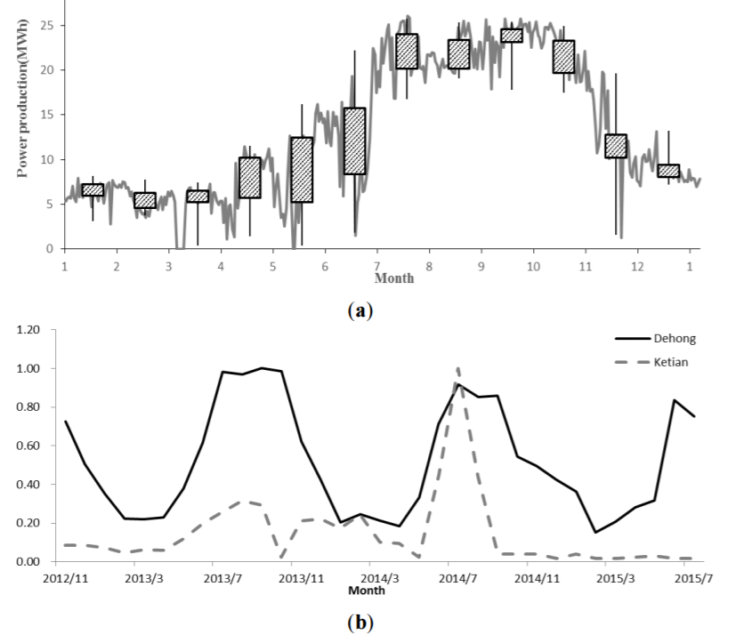
Randomness of a Single Plant
Influenced by rainfall and it is difficult to achieve stable regularity of power production
more outliers, stronger randomness and greater fluctuation

Slide 8
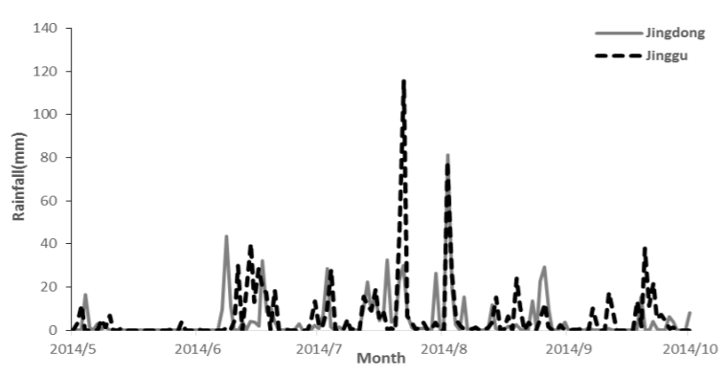
Spatial Differences
Each plant has different topography and landforms, the power production presents spatial differences.
Significant differences in rainfall and runoff formation occur because of Wuliang Mountain, Ailao Mountain and other mountains in this area

Slide 9
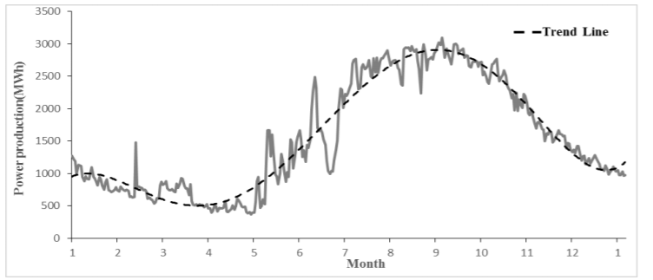
Similarity of Regions
Similarities in terms of hydrological and meteorological conditions
Monthly power production and trend line of SHP plants in county.

Slide 10
Continue
Summary / goal:
LHP plants can provide long-term historical data and accurate forecast values. Thus, historical data are used as a reference for the study of forecasting long-term SHP power production.
Made a regression model is developed to forecast the power production of SHP through the predictive value of LHP.

Slide 11
Step to make a correlation
SHP plants are considered to belong to the same area as a whole
Interval flow of the LHP plant is screened as the correlation factor.
correlation analysis of LHP and SHP is performed, and the significance of the correlation is tested.
a regression model is developed to forecast the power production of SHP through the predictive value of LHP.
* stronger correlation between power production of SHP plants and the interval flow of the LHP plant through the numerical simulation analysis. -> Things to learn or get some helps

Slide 12
The geographical and hydrological conditions of SHP plants are similar to that of LHP plant in the same region or neighborhood.
Interval flow of a set of candidate factors of LHP plants can reflect the runoff in the region where SHP plants are located, and there must be some correlationship between the interval flow of LHP plants and the power production of SHP plants in the same region. Then the correlativity of LHP and SHP in the region can be established.

Slide 13
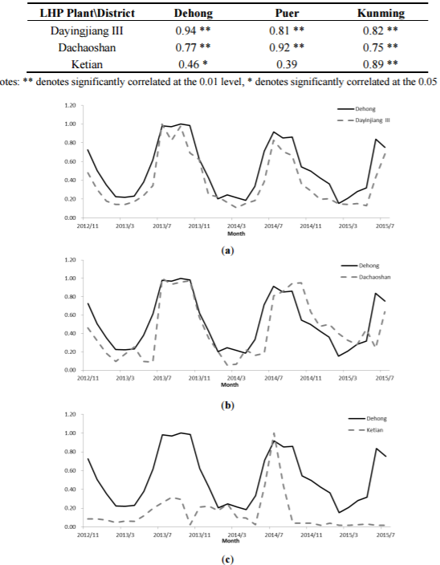
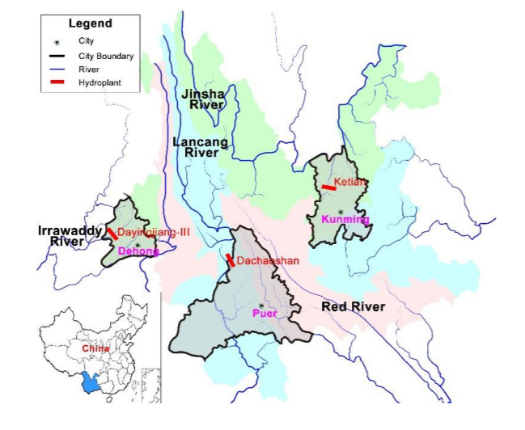
Case study in a district in China

Slide 14
Conclusion:
Power production of SHP plants shows significant correlation with the LHP plant of the same districts, whereas the correlation with the LHP plant in other districts is not significant.

Slide 15
Challenges
This method worked to forecast for SHP power generation given the data for LHP. However, in Mexico, most of them are LHP and we do not need to predict for SHP.
So, we need to confirm whether this method is working to forecast LHP as well.

Slide 16
Benefit
1. Great significance for realizing the coordination with LHP plants, solving the problem of the waste water and abandoned electricity and ensuring the safe operation of the power grid.
2. This method could achieve an accurate result, even during the flood season, which can provide the reliable forecasted data for arranging the coordinate power generation schedule between SHP plants and LHP plants.
3. Not much data is required. -> 1) only spatiotemporal characteristics, 2) the correlation between the power production of SHP plants and the interval inflow of LHP plants, 3) correlation characteristics in space
4. Generality of the correlation analysis method is demonstrated.
5. Finally, prediction accuracy of this method has been verified

Slide 17
3. Projecting changes in annual hydropower generation using regional runoff data
Summary / goal:
The basic idea for this method came from that climate change impacts on selected hydropower plants.
Motivated by the high correlation between Water runoff and hydropower generation, they conducted a series of regression analyses based on the annual time series of temperature, precipitation, runoff, and hydropower generation for each of the study areas.

Slide 18
Challenges
This generalized approach works for US federal hydropower plants because their total installed power capacity has not changed significantly during the past 20 years. (Mexico might be different)
This linear relationship, while working properly between annual runoff and generation, cannot be extended to seasonal or monthly scales.
This method works for SHP prediction.

Slide 19
4. The Role of Rainfall Variability in Reservoir Storage Management at Hydropower Dam
Summary / goal:
This method was suggested from the fact that reservoir operation and management is usually patterned after the background of long standing water resources management experience.
Records of rainfall-runoff relations for the study area suggests some level of variability in runoff due to rainfall variability; a condition which may impact on reservoir water balance
The objective is to develop functional hydrological relationship between (rainfall, inflow, reservoir storage and turbine releases) over the dam. This will provide scientific basis for operational decisions which can lead to optimum power plant utilization.
Correlation coefficients of the main meteorological variable (rainfall) on hydrologic and reservoir variables were computed to determine the strength of the relationship between the variables. These variables are: rainfall, reservoir inflow, reservoir storage and turbine release.

Slide 20
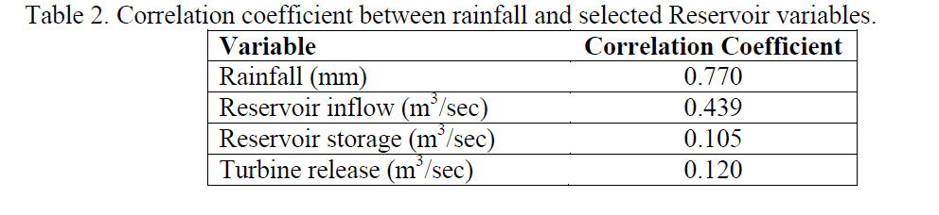
- Afterwards, the regression analyses of the correlated variables were done to develop regression model after equation 2.
y = ax +b.............................(2)
Where, X = time (year), a = slope coefficients and b = least square estimates of the intercept.
The low annual coefficient of variation in rainfall suggests that rainfall is less variable from year to year and that variability is greater between the months of May to October which coincides with rainy season, when more than 92% of annual rainfall is recorded.
The correlation coefficients between rainfall and other hydrologic and reservoir variables for Shiroro dam is presented in table 2.

Slide 21
A correlation coefficient of rainfall of 0.770 reveals a very strong relationship. The moderate rise in inflow of about 0.439 (44%) indicated non-significant decrease in inflow into Shiroro dam. The turbine release of about 12% and the corresponding increase in reservoir storage of 11% has helped maintain all year round power generation at the dam.

Slide 22
Conclusion
Hydropower generation varies from year to year for a number of reasons, including variations in weather and runoff, the changing condition of hydropower equipment, nonpower water uses and environmental requirements.
Hydrologic Variability which is jointly influenced by precipitation, evaporation, snowfall, soil moisture, groundwater and reservoir operation was found to be a significant factor in the annual hydropower generation. However, given the large number of federal hydropower plants and the diverse hydrologic conditions, evaluating the impacts of climate change on all federal hydropower plants through a conventional reservoir-based approach is currently not tractable in a single national-scale study.
- Given the complexity of energy water facilities and limited information of existing hydropower data, it is unlikely to address all issues across multiple power plants and scales using a single model. Depending on the scale (e.g., national, regional, or plant-wise) and the nature of the problem (e.g., reservoir operation, risk assessment, or resource planning), one would likely need to develop different kinds of models for different challenges.

Slide 23
Challenges
Hydrologic Variability which is jointly influenced by precipitation, evaporation, snowfall, soil moisture, groundwater and reservoir operation was found to be a significant factor in the annual hydropower generation. However it is hard to track all the conditions.

Slide 24
Conclusion
Given the complexity of energy water facilities and limited information of existing hydropower data, it is unlikely to address all issues across multiple power plants and scales using a single model.
Depending on the scale (e.g., national, regional, or plant-wise) and the nature of the problem (e.g., reservoir operation, risk assessment, or resource planning), one would likely need to develop different kinds of models for different challenges.

